Slide 1
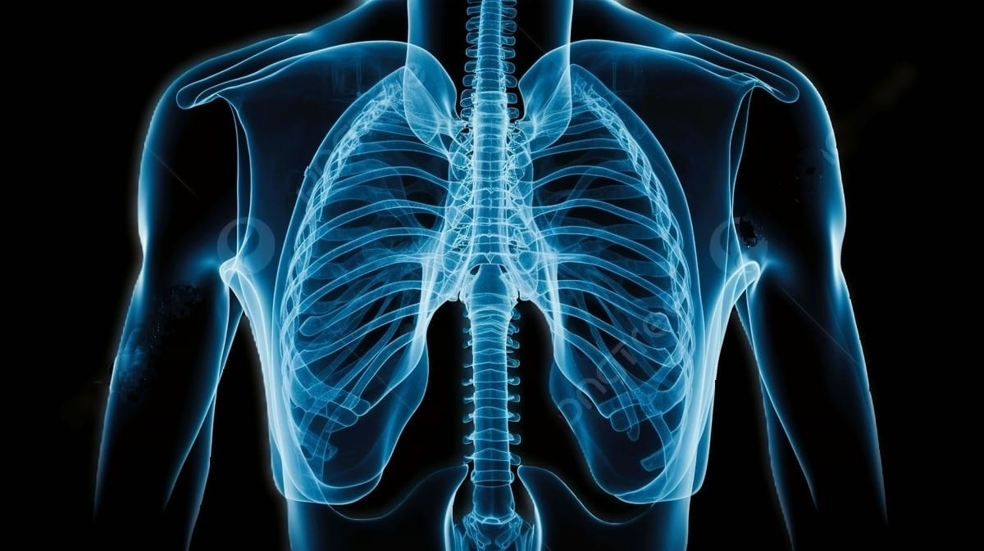
CHEST X-RAY CLASSIFICATION USING DEEP LEARNING
Presented by
Sasmita Sahoo (210301120081)
Prangya Paramita Pani (210301120118)
Mamali Sahoo (210301120142)
Omm Prasad Singh (210301120138)
Guided by
Dr. Chinmayee Dora

Slide 2
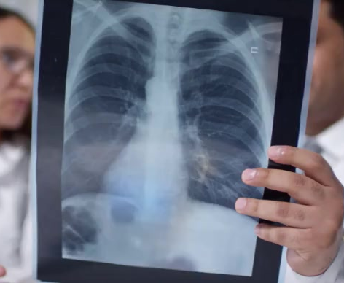
CONTENTS
TEAM MEMBERS
INTRODUCTION
OBJECTIVE
BLOCK DIAGRAM
WORK FLOW
SOFTWARE USED
DATASET DESCRIPTION
CODING IMPLEMENTATION
RESULT AND DISCUSSION
REFERENCES
COMPARITIVE ANALYSIS
TIMELINE
POSTER
PHOTO GALLERY

Slide 3

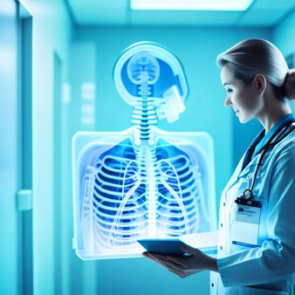

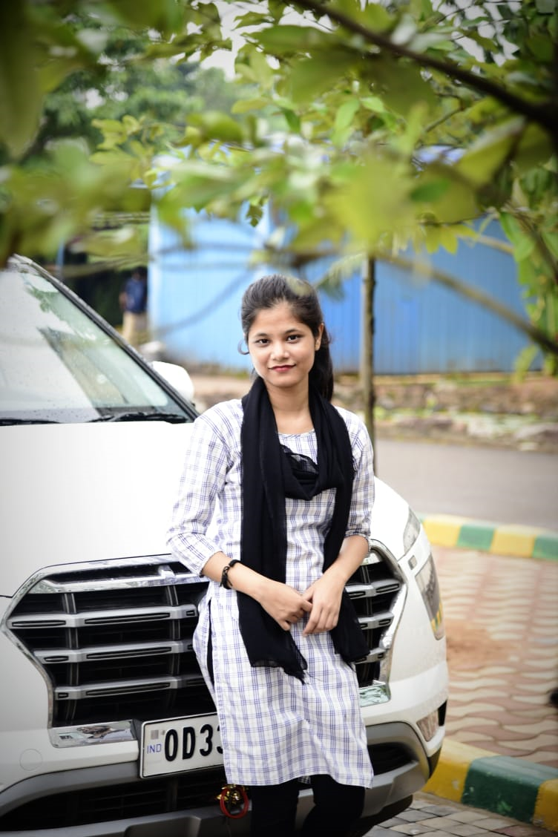


TEAM MEMBERS
Sasmita Sahoo
Prangya P. Pani
Coding implementation
Document preparation
Dataset collection and background literature work
Diagram preparation and techniques searched
Mamali Sahoo
Omm Prasad Singh

Slide 4
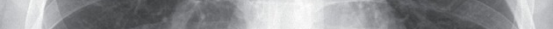
INTRODUCTION
A global health challenge has been created by the widespread growth of diseases like pneumonia, lung cancer, COVID-19, and heart abnormalities. However, the traditional manual analysis of chest X-ray images by medical professionals requires expertise, which is also highly prone to human error and may result in delays in patient care. The rapid and accurate identification of these diseases becomes crucial to stopping their spread and guaranteeing early treatments.
So, this research of chest X-ray classification system aims to dramatically increase diagnostic efficiency and accuracy in clinical settings. Our comprehensive approach integrates preprocessing, feature extraction using convolutional neural networks models. Thorough evaluation and hyperparameter optimization play an essential role in the effective classification of these kinds of scenarios. The study offers encouraging results and enhances healthcare solutions by emphasizing the potential emerging deep learning techniques and their integration to medical image analysis.

Slide 5
OBJECTIVE
The objectives of a Chest X-ray classification project typically involves machine learning techniques for automatic analysis of medical images. Here are some key objectives :
Develop a system capable of automatically classifying common chest conditions, such as pneumonia, COVID-19, lung cancer from X-ray images. Aim to improve the accuracy of diagnosis by utilizing machine learning algorithms, reducing the chances of misinterpretation and assisting healthcare professionals in making informed decisions.
Early Detection: Focus on early detection of chest abnormalities, enabling timely intervention and treatment, which is critical for better patient outcomes.
Workload Reduction for Radiologists: Reduce the workload of medical experts and radiologists by providing an automated tool for preliminary analysis.

Slide 6
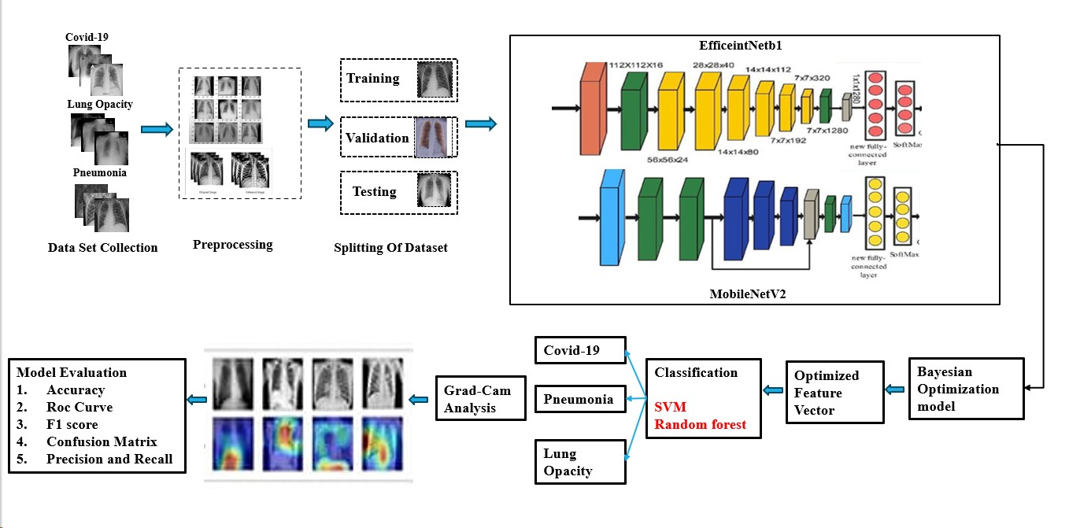
BLOCK DIAGRAM

Slide 7
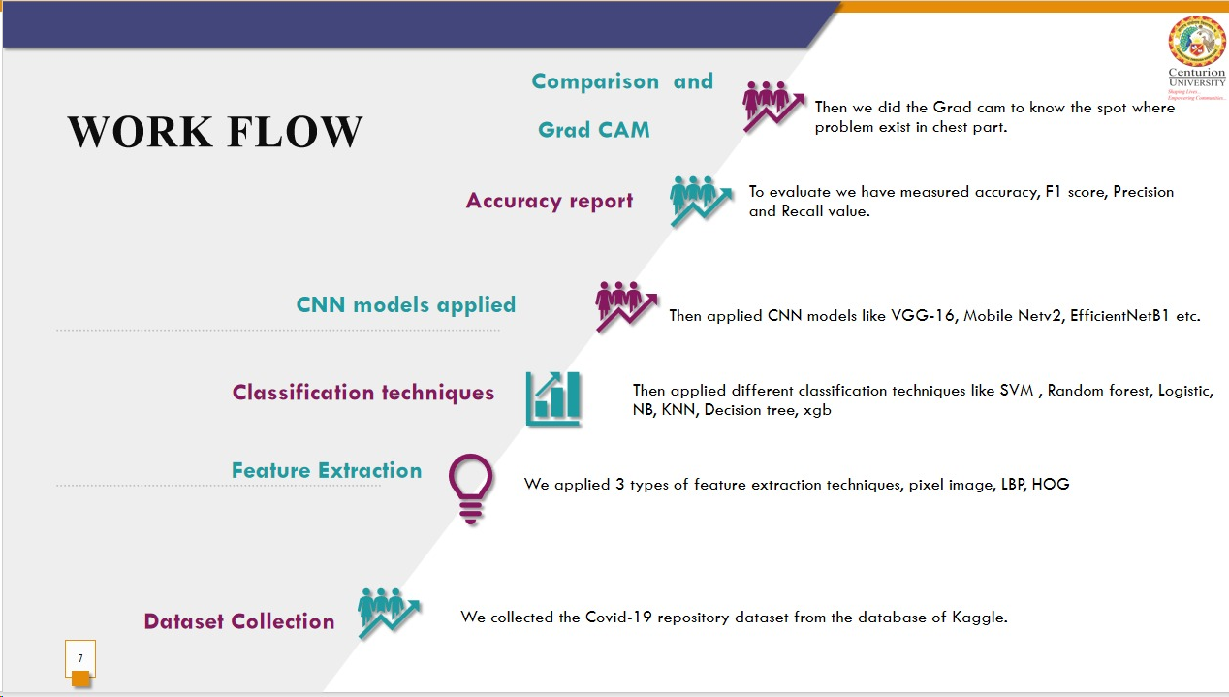

Slide 8
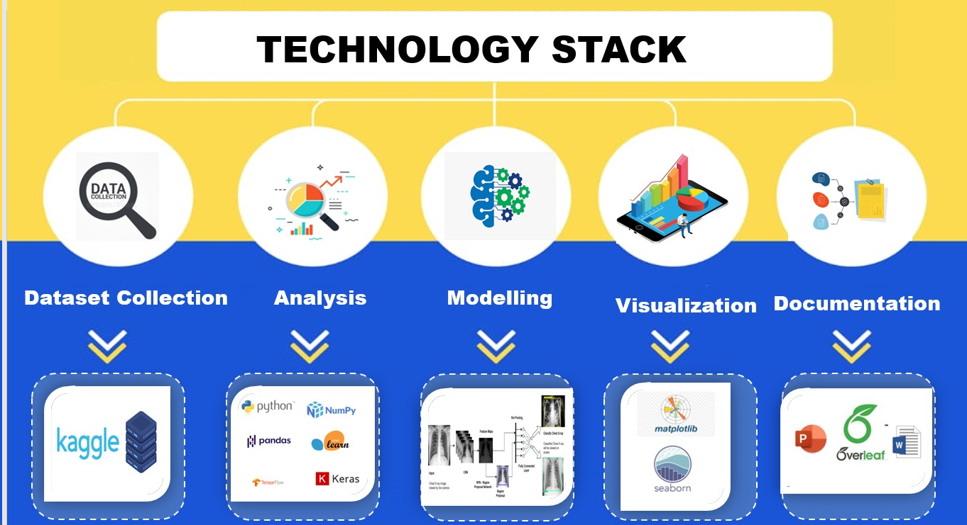
SOFTWARE USED

Slide 9
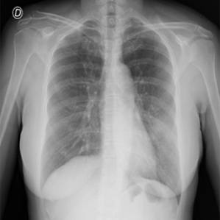
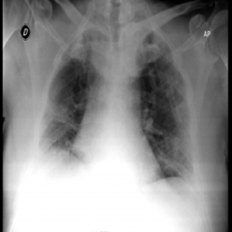
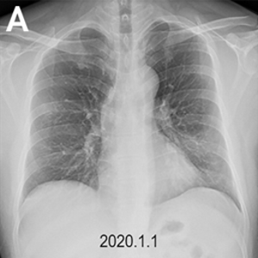
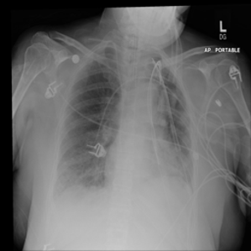
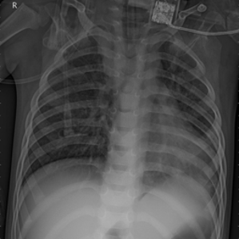
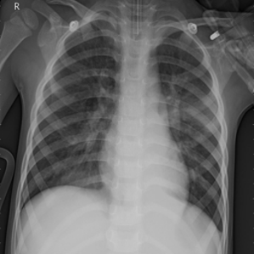
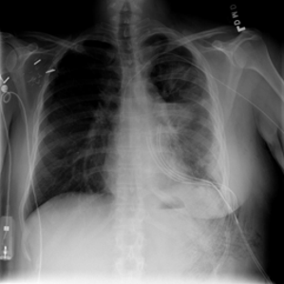

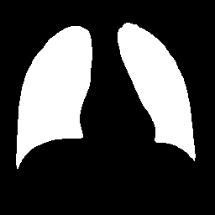

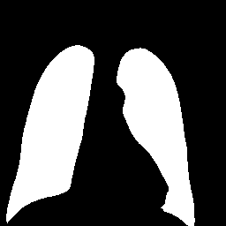
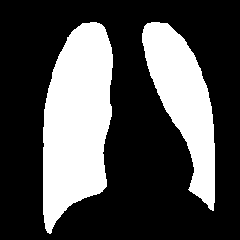


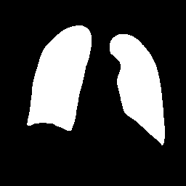
DATASET DESCRIPTION
Dataset Name: Covid-19 Radiography Database
Source of Dataset: Kaggle
Total no. of Images: 21, 165
Covid-19 Images: 3616
Lung Cancer: 6012
Normal : 10,192
Pneumonia: 1345
All the images are in Portable Network Graphics (PNG) file format
The resolution are 299*299 pixels.

Slide 10
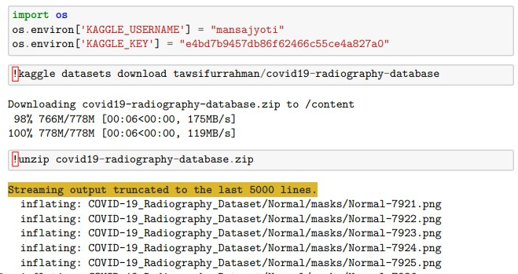
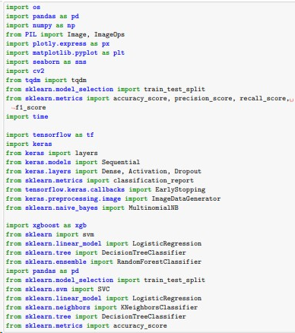
CODING Implementation
Downloading dataset using Google colab os environ and unzipping it.
Importing different necessary libraries.

Slide 11
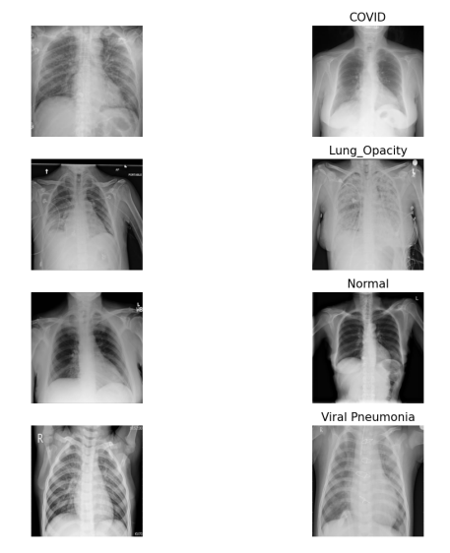
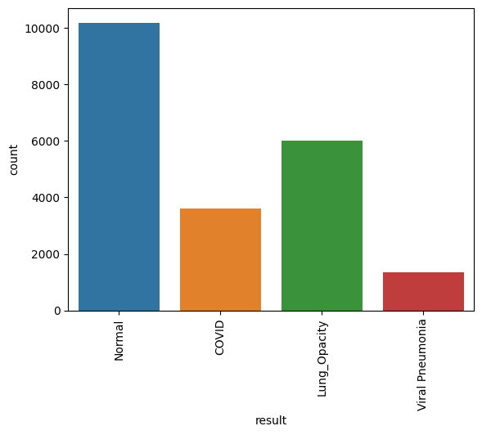
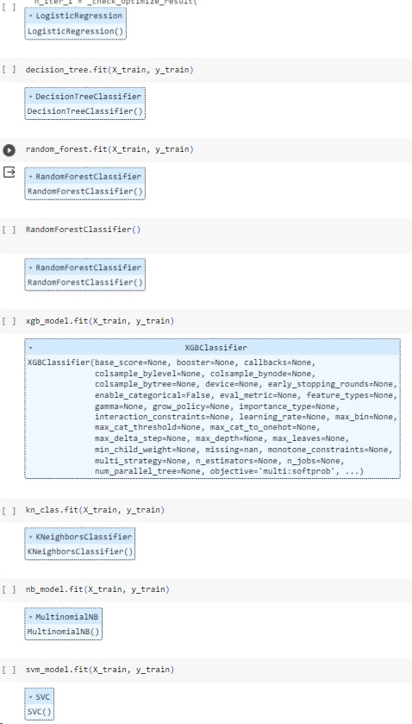
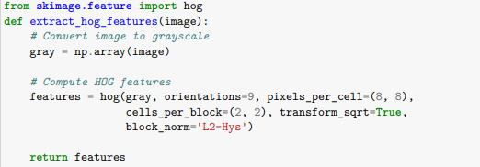
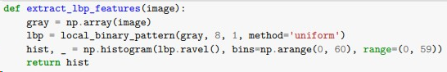
Sample of data images.
Bar plot of count value of different class level data.
Applying different features extraction techniques.
Applying different machine learning models.

Slide 12
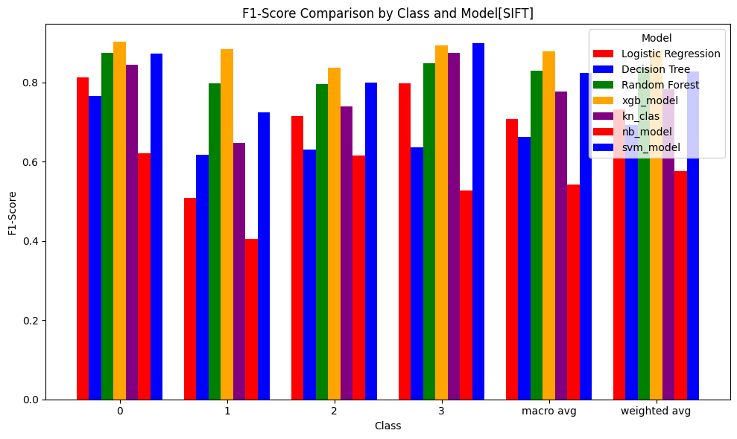
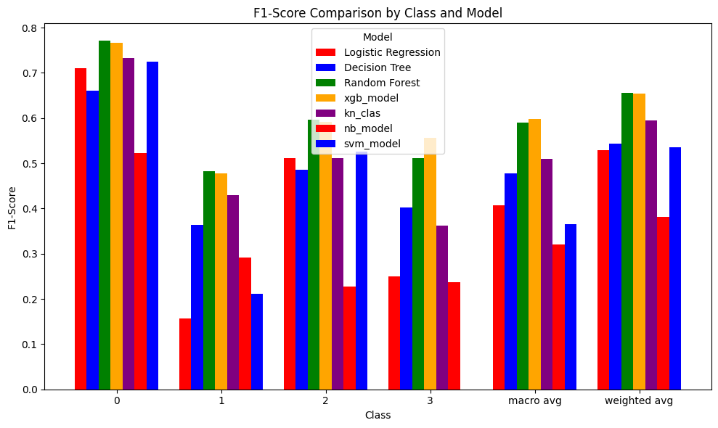
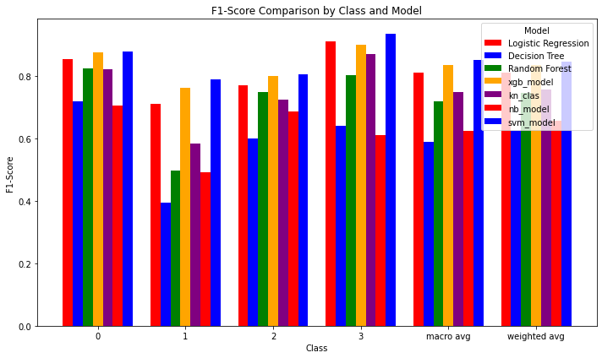
Accuracy of machine learning techniques with pixel feature extraction.
Accuracy of machine learning techniques with lbp feature extraction.
Accuracy of machine learning techniques with hog extraction.

Slide 13
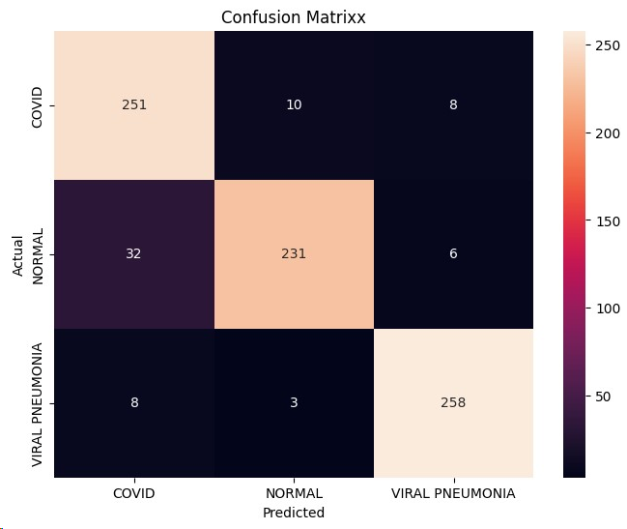
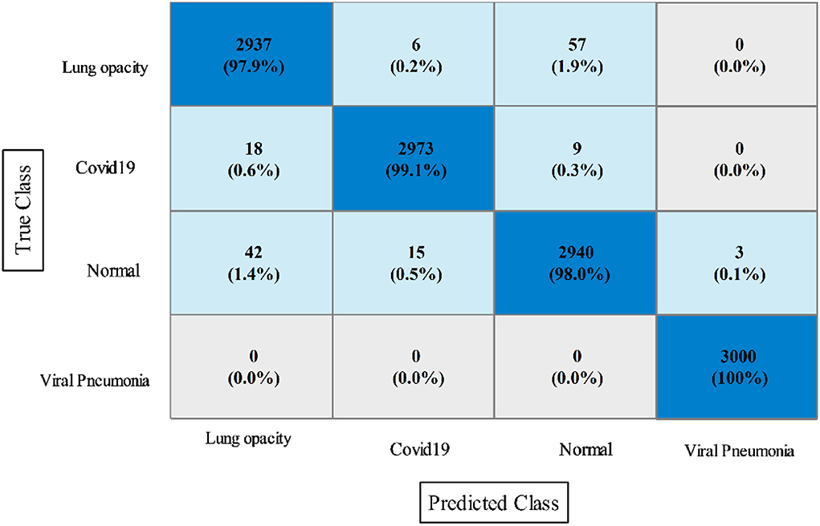
Confusion matrix with VGG-16.
Confusion matrix with EfficientNet B0.

Slide 14
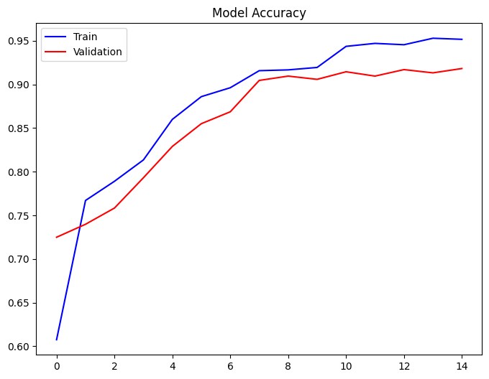
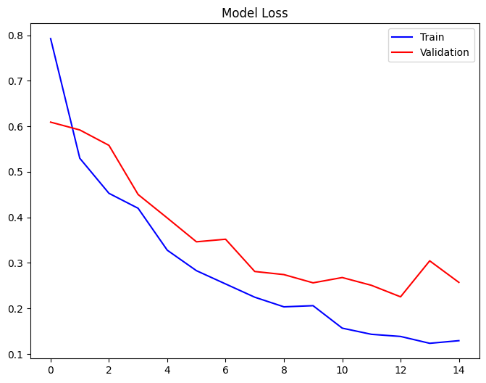

Slide 15
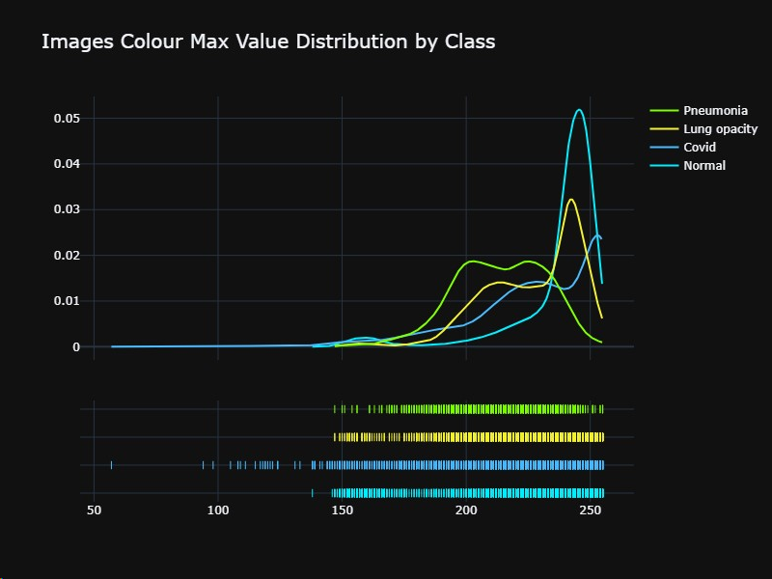
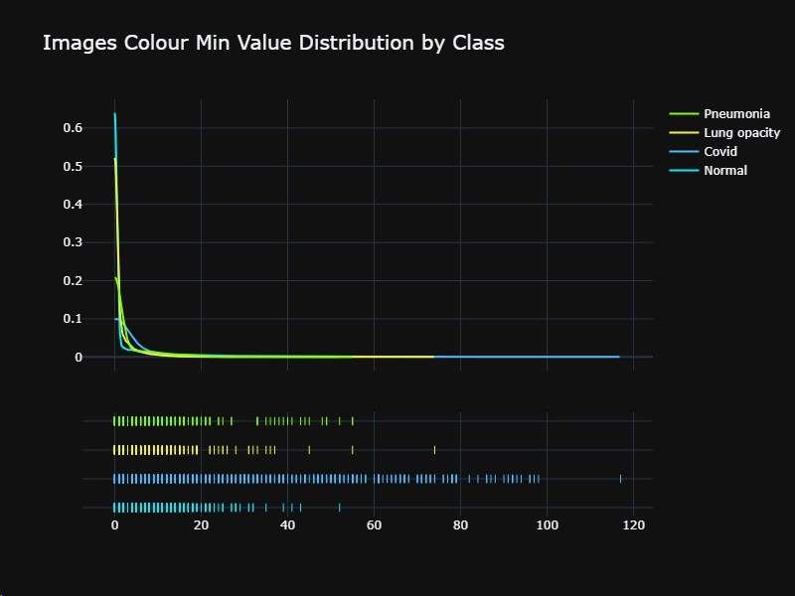
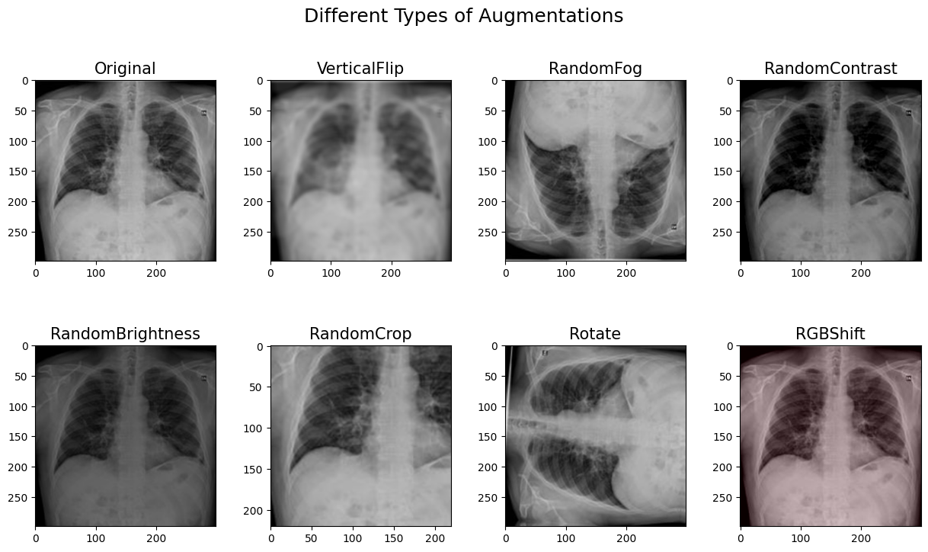
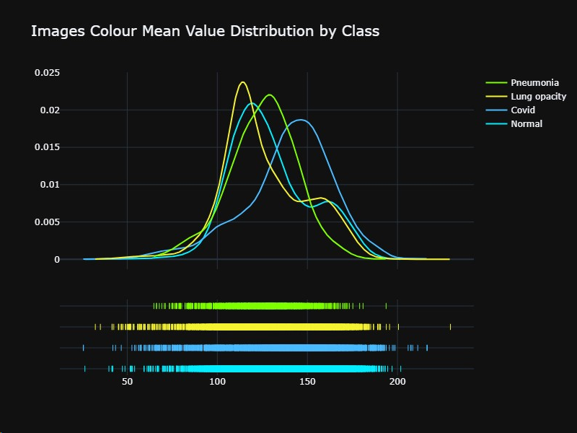
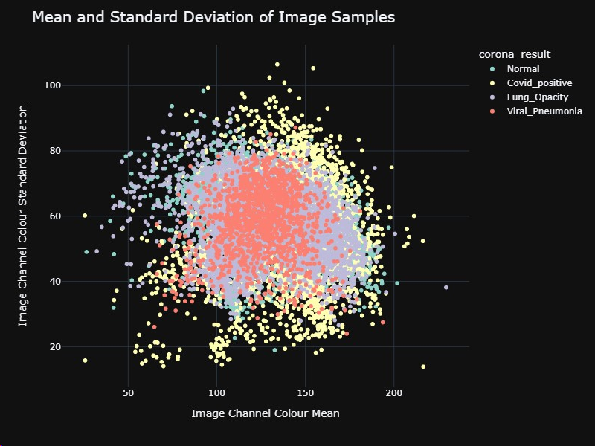
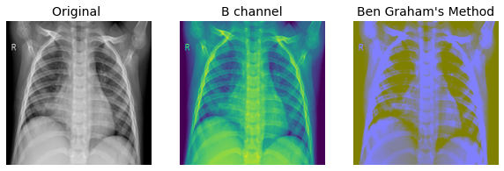
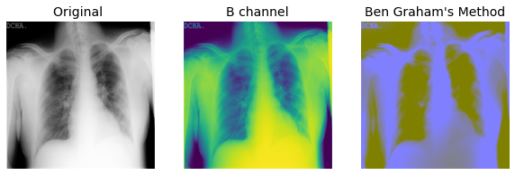
Grad-cam Implementation

Slide 16
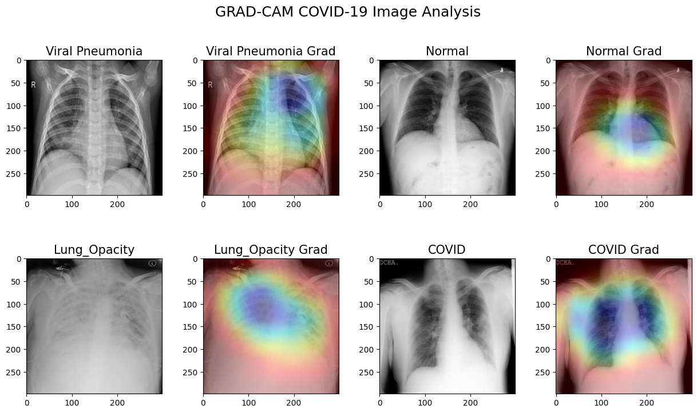

Slide 17
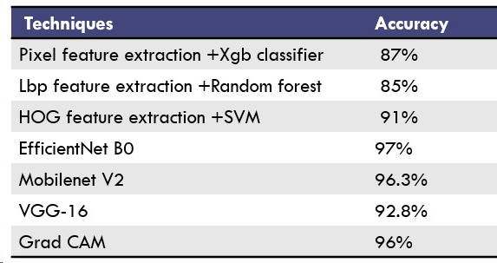
RESULT AND DISUSSION
We got good accuracy in classifying chest X-ray images into three categories, including COVID-19, lung opacity and pneumonia, using advanced deep learning and classification techniques such as EfficientNetB0 and MobileNetV2 , VGG-16 with SVM.
To further enhance accuracy of the system, we can explore different modern optimization techniques.

Slide 18
COMPRATIVE ANALYSIS
Study | Method | Accuracy | Recall | Precision | F1-Score
[Ahmed et al., 2021] | CNN | 90.64 | 80 | 92 | 89.8
[Choudhuri & Paul,2021] | VGG16 | 98.3 | 88 | - | -
[Marques et al, 2020] | EfficientNet | 96.70 | 96.69 | 97.59 | 97.11
[Ucar & Kokmaz,2020] | SqueezeNet | 98.3 | - | - | 98.3
[Ozturk et al,. 2020] | DarkCovidNet | 87.02 | 85.35 | 89.96 | 87.37
[Torman et al., 2020] | CapsNet | 84.22 | 84.22 | 84.61 | 84.21

Slide 19
TIME LINE
WORK | DESCRIPTION | TIME | PROGRESS
Team members selection | Selecting 4 members for our project | 2 days | Completed
Project topic selection | Finalised the topic | 1 days | Completed
Setting up the working environment and data collection | Google colab and jupyter setting and data from covid repository | 2 days | Completed
Coding Implementation | Tested the model and it’s accuracy | 4 -5 weeks | Completed
Documentation making | Report in over leaf and ppt making | 4-8 days | Completed

Slide 20
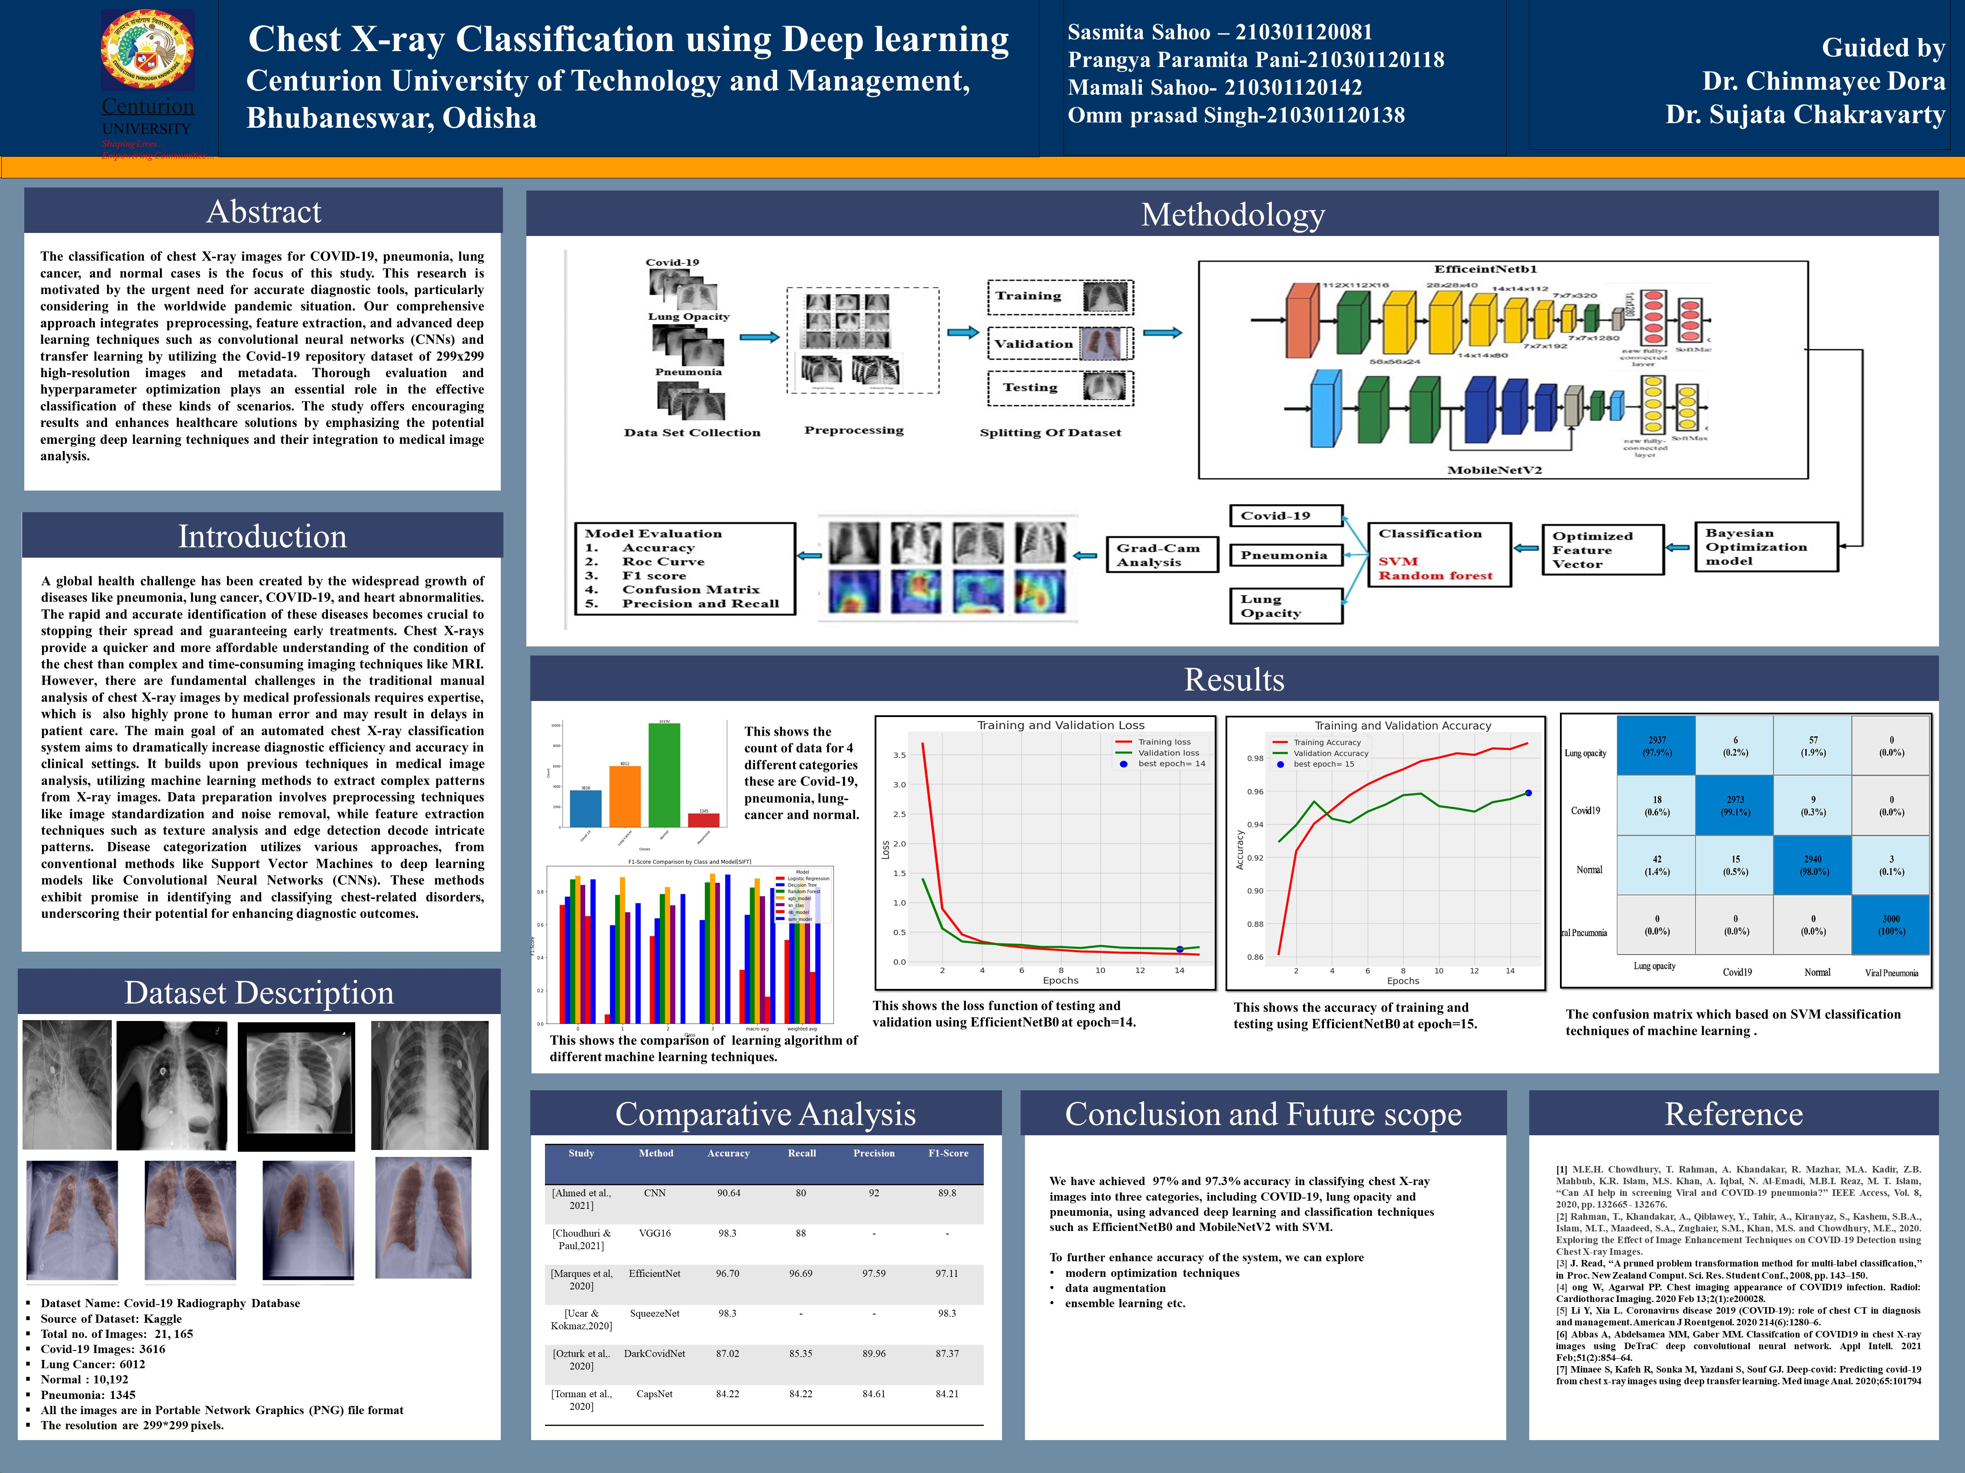
POSTER

Slide 21
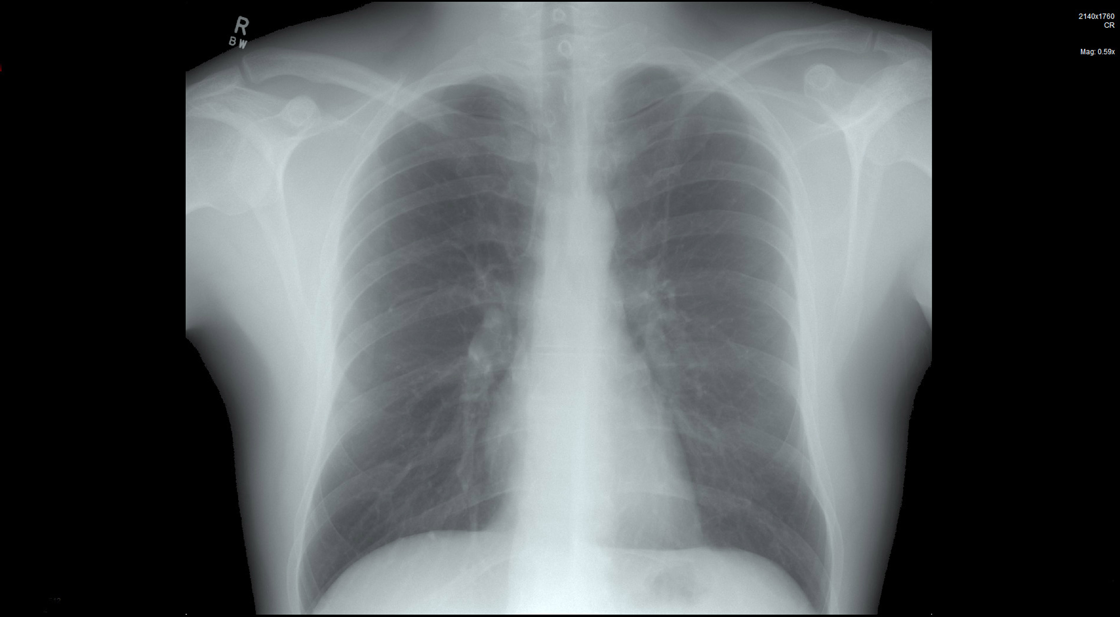
THANK YOU

